Slide 1
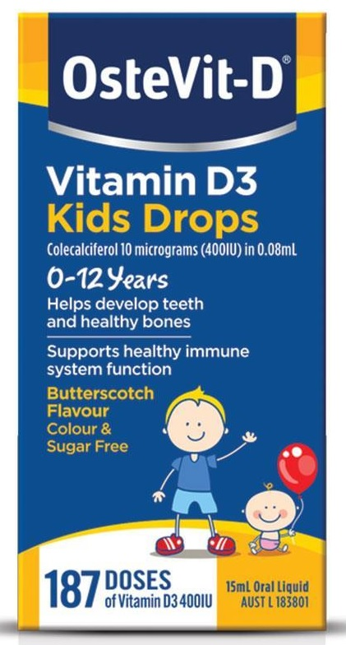
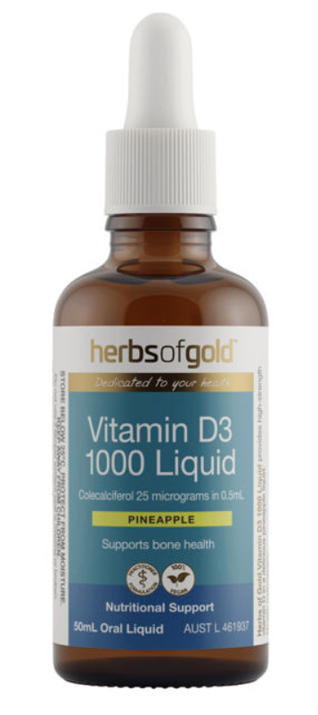
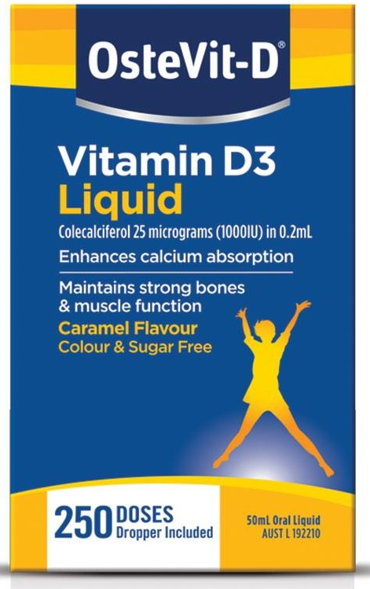
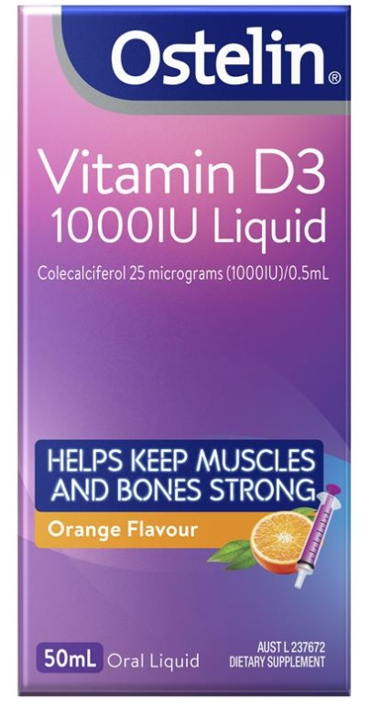
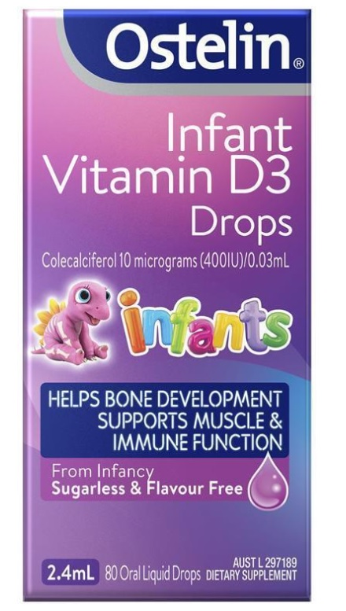
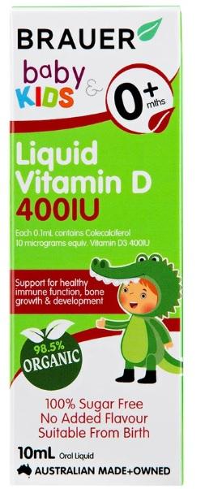
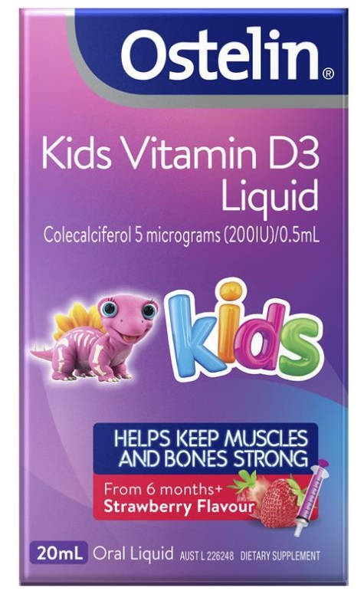
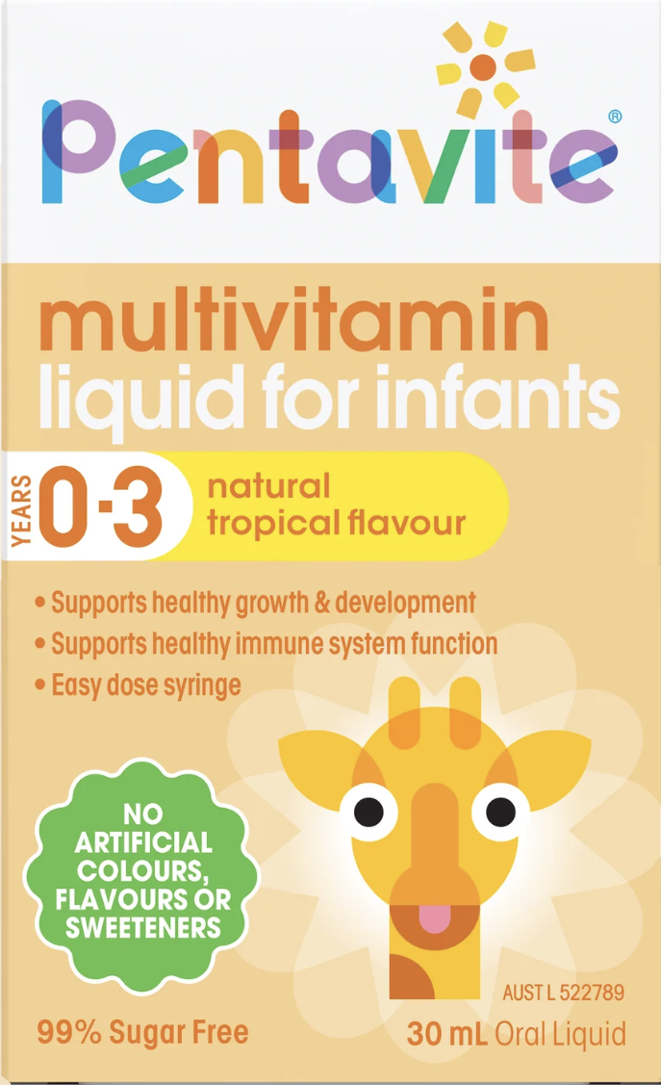
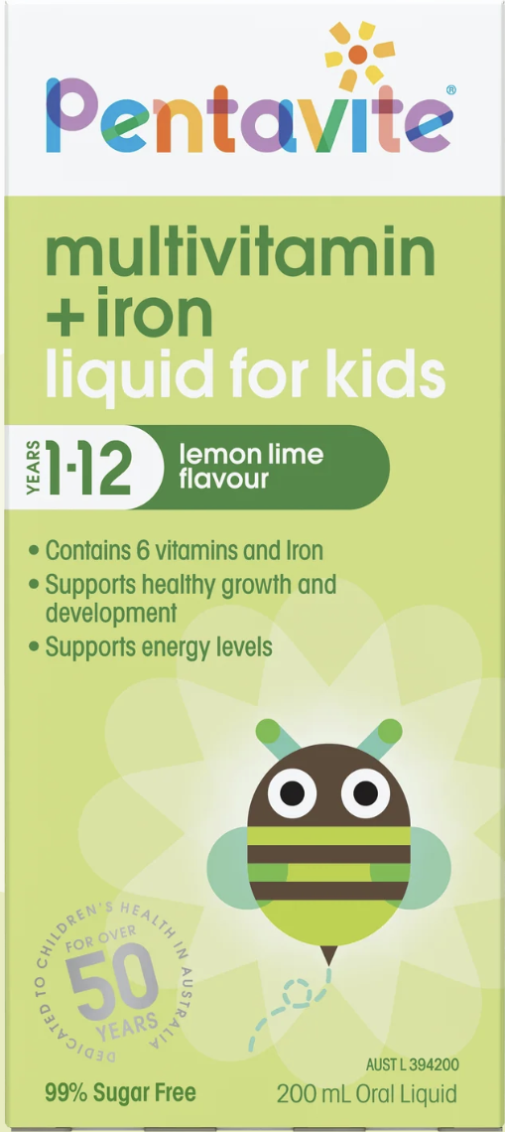
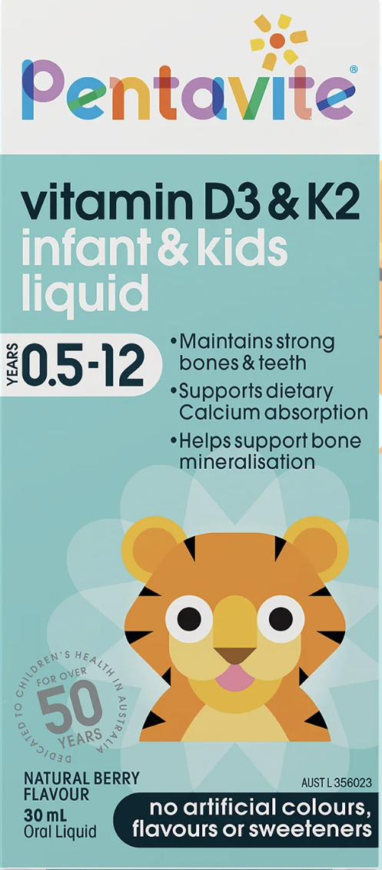
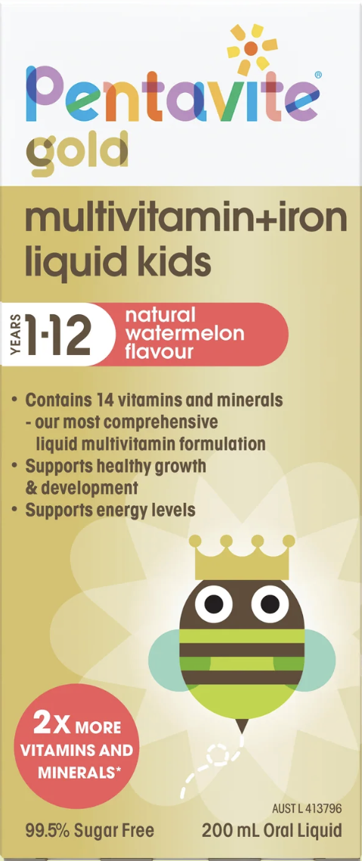
Vitamin D photo board
LIQUID AND DROPS
Vitamin D ONLY Liquid & Drops
Product specifications
(number of doses as per manufacturer)
25mcg(1000IU)/0.2mL
10mcg(400IU)/0.08mL
25mcg(1000IU)/0.5mL
25mcg(1000IU)/0.5mL
10mcg(400IU)/0.03mL
50mL, 250 doses
15mL, 187 doses
50mL, 100 doses
50mL, 100 doses
2.4mL, 80 doses
Cost range#
$13.50-19.95
$6.50-12.99
$19.95- 33.99
$17.99 – 29.95
$9.99-18.99
Cost per 400IU Cost per dose
3c per 400IU
6-8c per 1000IU
5-7c per 400IU
7-13c per 400IU
19-33c per 1000IU
8-12c per 400IU
18-30c per 1000IU
13-23c per 400IU
# Price estimates based on prices documented by three pharmacy brands: Chemist Warehouse, Priceline and Terry White Chemists.
Current - April 2026
p/h refers to online pricing inclusive of postage and handling
Product specifications
(as per manufacturer)
10mcg(400IU)/0.1mL
5mcg(200IU)/0.5mL
10mL, 100 doses
20mL, 40 doses
Cost range#
$20.40-$28.94
$9.99 – 14.99
Cost per 400IU Cost per dose
20-29c per 400IU
50-75c per 400IU
25-37c per 200IU
Combination Vitamin D liquids
Product specifications-
Vit D content
(as per manufacturer)
other ingredients as listed
10mcg(400IU)/0.45mL
Vit A, B1, B2, B3, B6, C
5mcg(200IU)/5mL
Vit A, B1, B2, B3, B6, C & Iron
5mcg(200IU)/0.5mL
Vit K2
5mcg(200IU)/10mL
Vit A, B1, B2, B3, B5, B6, B12, C, Biotin, K, Iron, Ca, Zinc
Cost range#
30mL, 50 doses
200mL, 40 doses
30mL, 60 doses
200mL, 20 doses
$19.99
$11.99 – 23.99
$11.47-22.95
$13.99-27.99
Cost per 400IU Cost per dose
40c per 400IU
60c-$1.20 per 400IU
30-60c per 200IU
38-76c per 400IU
19-38c per 200IU
$1.40-1.80 per 400IU
70-90c per 200IU
Page 1 of 3

Slide 2
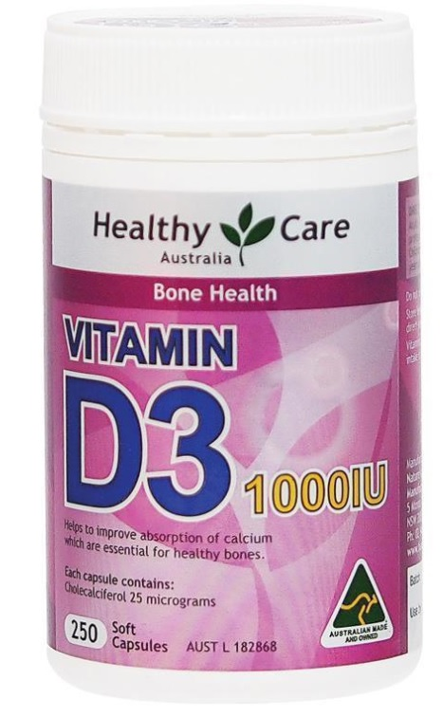
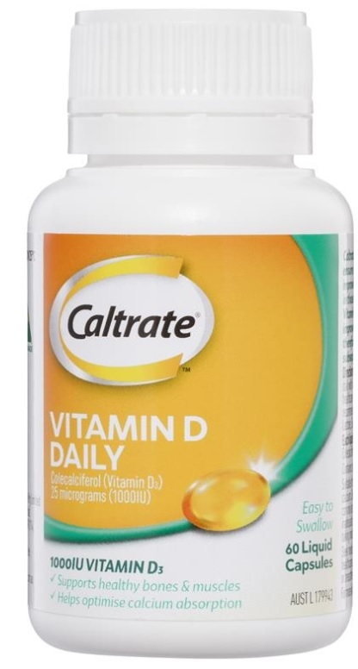
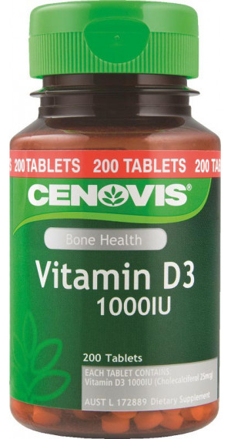
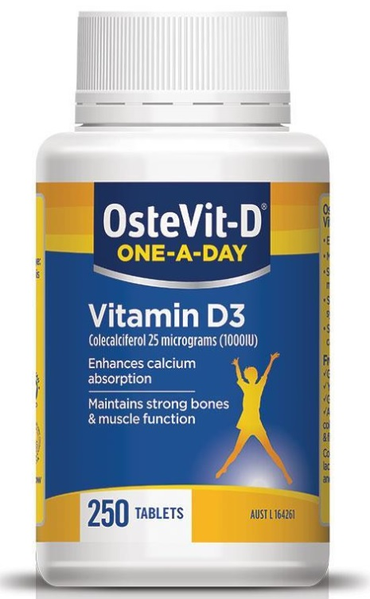
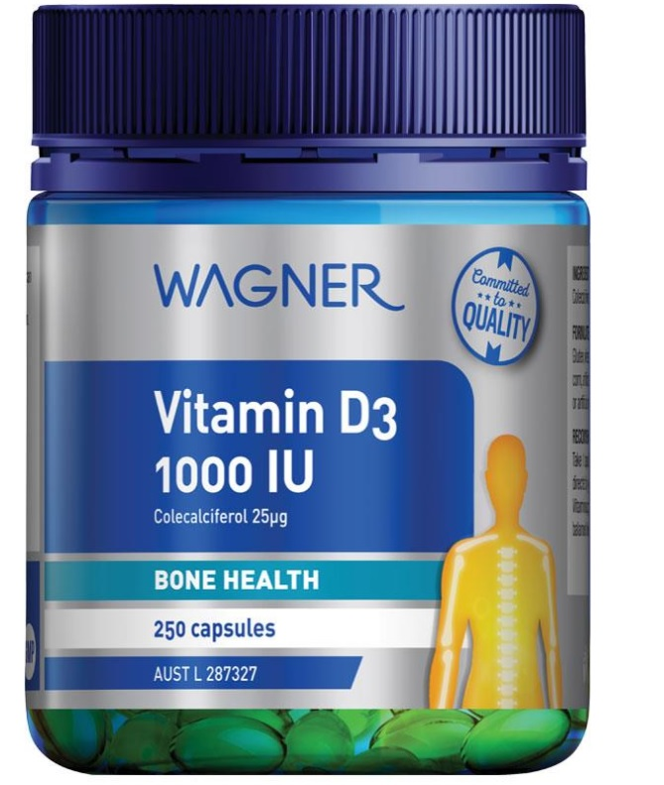
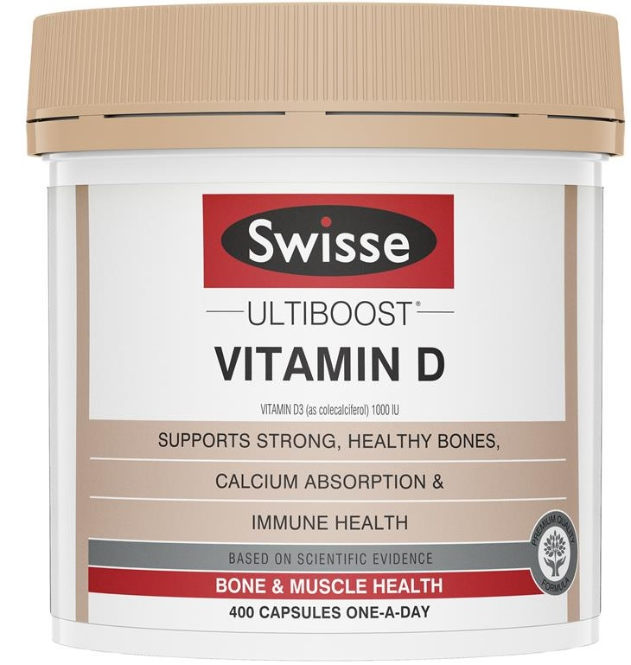
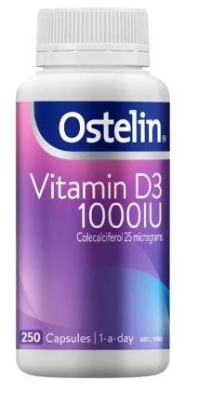
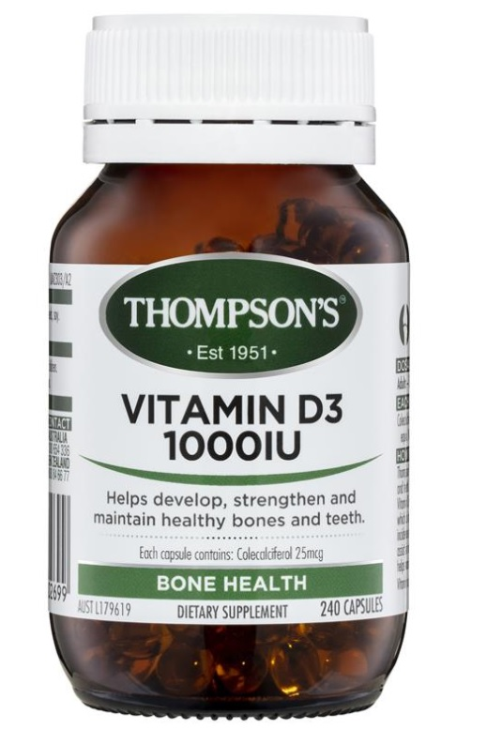
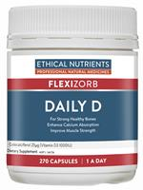
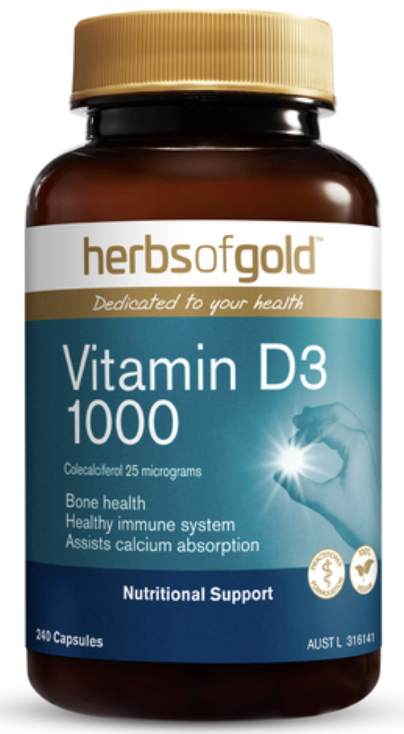
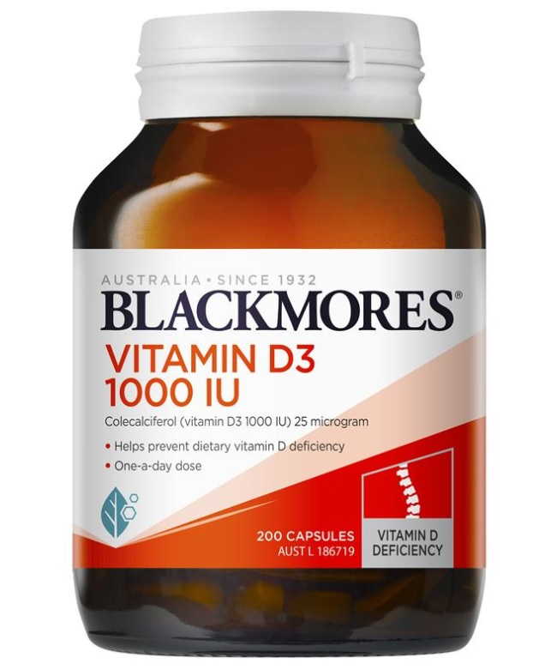
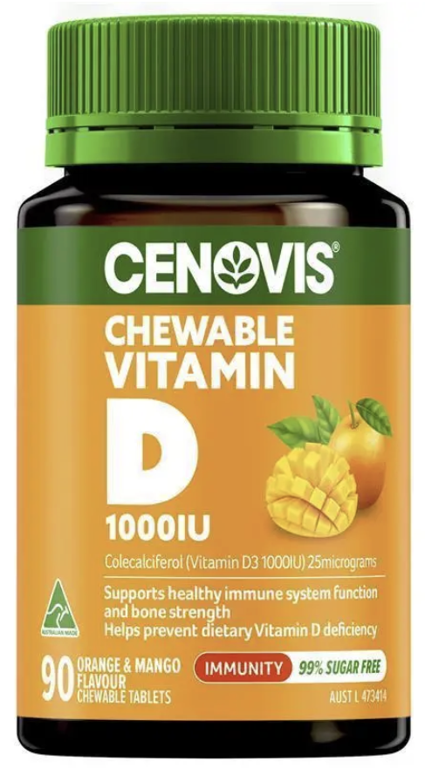
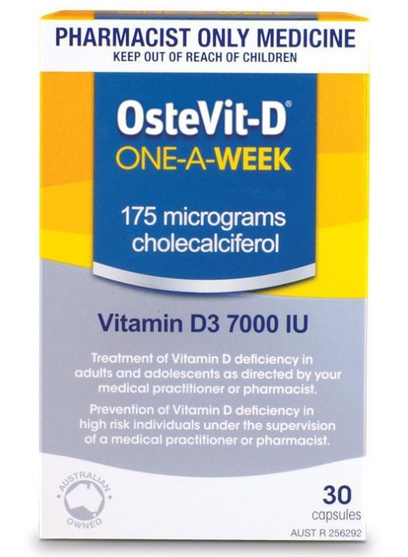
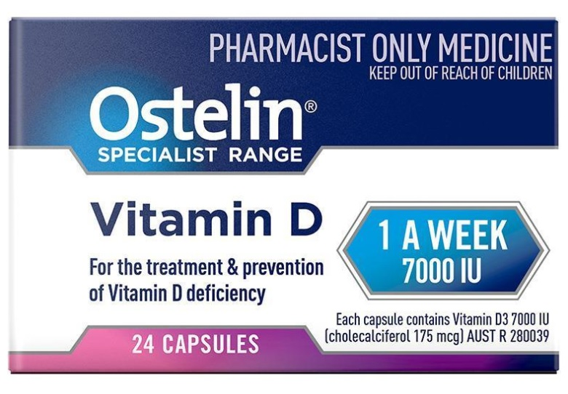
Vitamin D photo board
VITAMIN D ONLY TABLETS/CAPSULES
Standard Adult Strength
Product specifications
(as per manufacturer)
25mcg (1000IU) 500 capsules
25mcg (1000IU) 500 capsules
25mcg (1000IU) 500 capsules
25mcg (1000IU) 300 capsules
25mcg (1000IU) 200 tablets
25mcg (1000IU) 250 tablets
Cost range#
$19.99 – 23.99
$25.49
$24.99-28.99
$18.99
$14.00
$13.97-27.95
Cost per 1000 IU
4-5c
5c
5-6c
7c
7c
6-11c
Product specifications
(as per manufacturer)
25mcg (1000IU) 300 capsules
25mcg (1000IU) 240 capsules
25mcg (1000IU) 270 capsules
25mcg (1000IU) 240 capsules
25mcg (1000IU) 200 capsules
25mcg (1000IU) 90 chewable tablet
Cost range#
$29.99-34.99
$27.49
$28.99
$35.99
$22.99-37.49
$9.99 – 19.99
Cost per 1000 IU
10-11c
11c
11c
14c
11-18c
11-22c
Higher Strength*
# Price estimates based on prices documented by three pharmacy brands: Chemist Warehouse, Priceline and Terry White Chemists.
Current - April 2026
p/h refers to online pricing inclusive of postage and handling
Product specifications
(as per manufacturer)
175mcg (7000IU) 50 capsules
175mcg (7000IU) 48 capsules
Cost range#
$29.99
$42.99
Cost per dose
60c
89c
Cost per 1000 IU
9c
12c
*pharmacist only preparations
Page 2 of 3

Slide 3


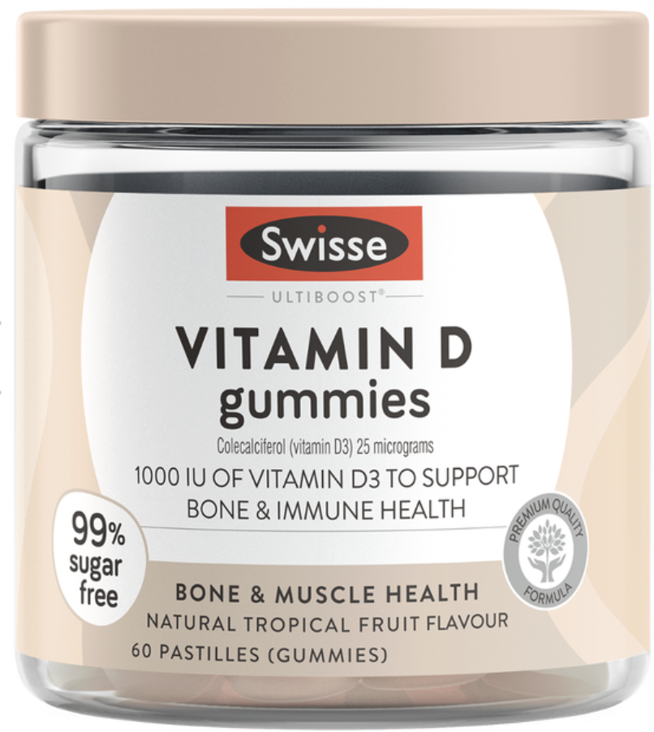
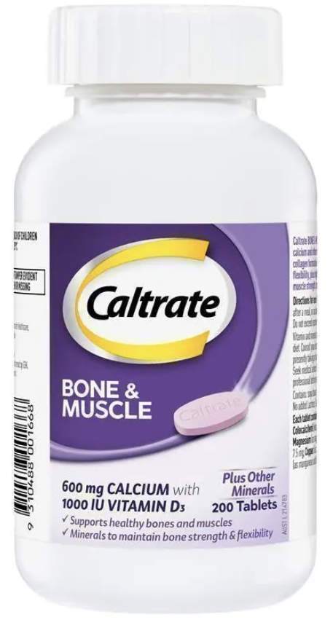
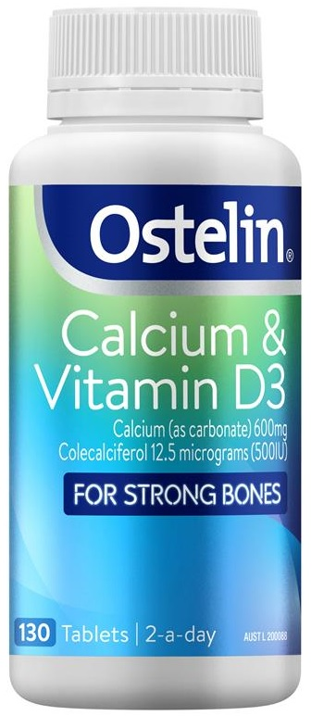
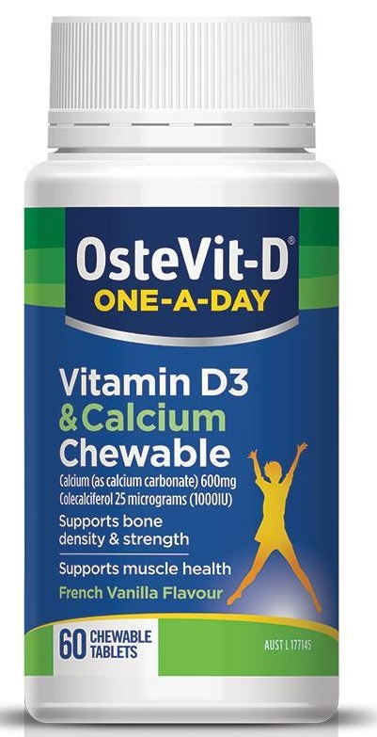
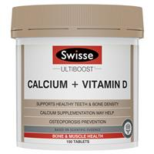
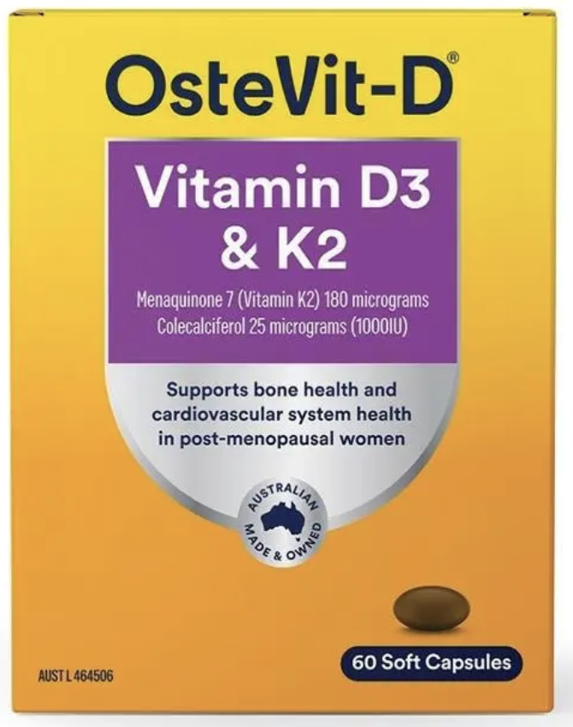
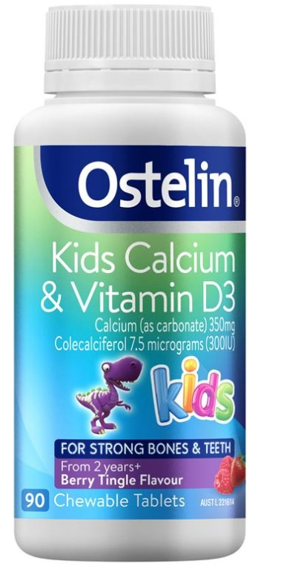
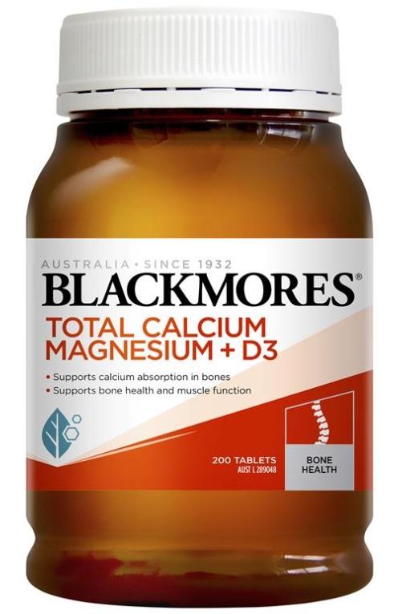
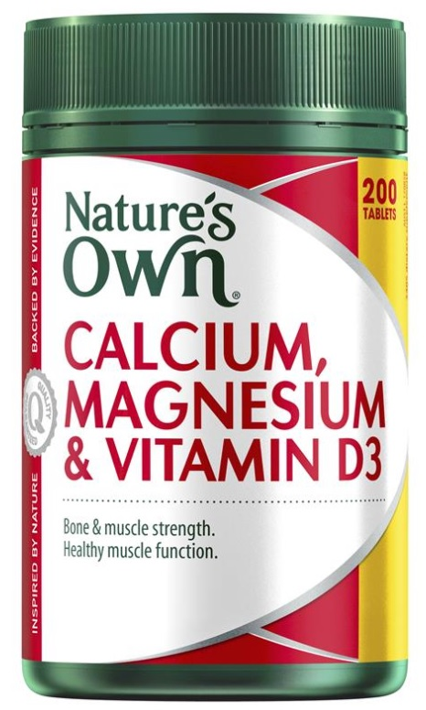
Vitamin D photo board
COMBINATION PRODUCTS
Gummies (Vit D only & Combination)
# Price estimates based on prices documented by three pharmacy brands: Chemist Warehouse, Priceline and Terry White Chemists.
Current - April 2026
p/h refers to online pricing inclusive of postage and handling
Product specifications
(Vitamin D content, other ingredients listed)
25mcg(1000IU)
5mcg(200IU)
Ca
2.5mcg(100IU)
Vit A, B3, B6, B12, C, E, K2, Biotin, Potassium Ca, Zinc
60 Gummies
60 Gummies
60 Gummies
Cost
$29.99
$14.99 – 17.99
$17.99
Cost per TABLET
50c
24 -30c
30c
Cost per 1000 IU
50c
$1.20 – 1.50
$3
Combination Capsules & Tablets
Product specifications
(Vitamin D content, other ingredients listed)
25 mcg(1000IU)
Ca, Mg, Zn, Cu, Mn
12.5mcg(500IU)
Ca
25mcg(1000 IU)
Ca
8.3 mcg(333 IU)
Ca
5mcg(200IU)
Ca, Mg
200 tablets
300 tablets
60 chewable tablets
150 tablets
200 tablets
Cost range
$14.99 - 20.99
$29.99
$8.97-17.95
$17.99-34.99
$24.99
Cost per TABLET
8-10c
10c
14-30c
12-23c
12c
Cost per 1000 IU
8-10c
20c
23-24c
36-70c
62c
Product specifications
(Vitamin D content, other ingredients listed)
5mcg(200 IU)
Ca, Mg, Zn, Mn, Vit C, Vit K1, folic acid
5mcg(200IU)
Ca, Mg
7.5mcg(300IU)
Ca
Cost range
200 tablets
200 tablets
90 chewable tablets
$26.99 – 47.99
$24.99
$10.99
Cost per TABLET
13-23c
12c
12c
Page 3 of 3
Cost per 1000 IU
50-85c
62c
40c

